Slide 1
2025 Presbyteral Day of Sanctification

Slide 2
Rev. Matthew Cortnik
Rev. Mark Latcovich
Rev. Stephen Moran
A Year of Grace and Renewal through the Power of Christ’s Resurrection
Tuesday, April 15, 2025

Slide 3
Rev. Matthew Cortnik
Pastor
Ss. Cosmas and Damian Parish
Twinsburg, Ohio
Dean of the Suburban Southeast Deanery

Slide 4
The Power of Christ’s Resurrection

Slide 5
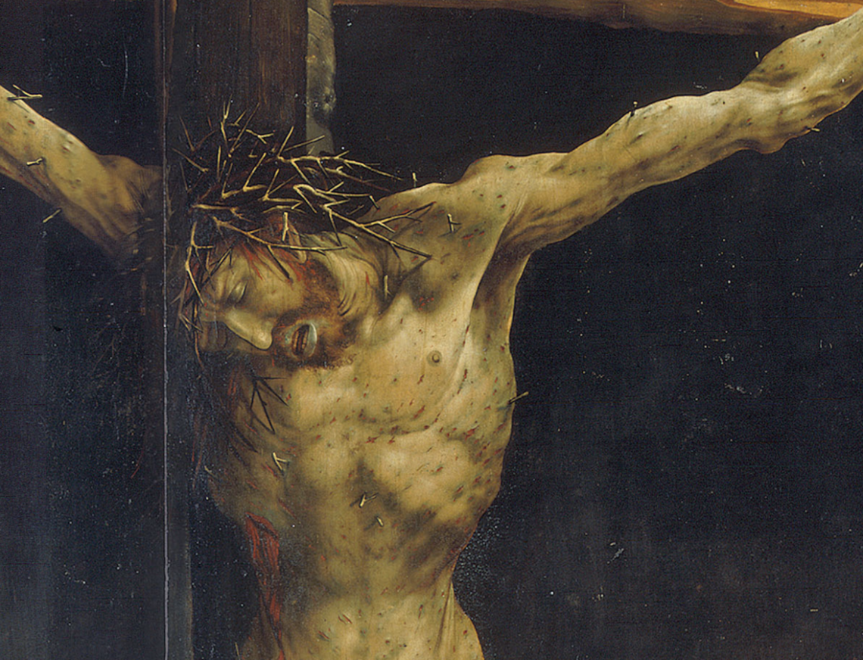

Slide 6
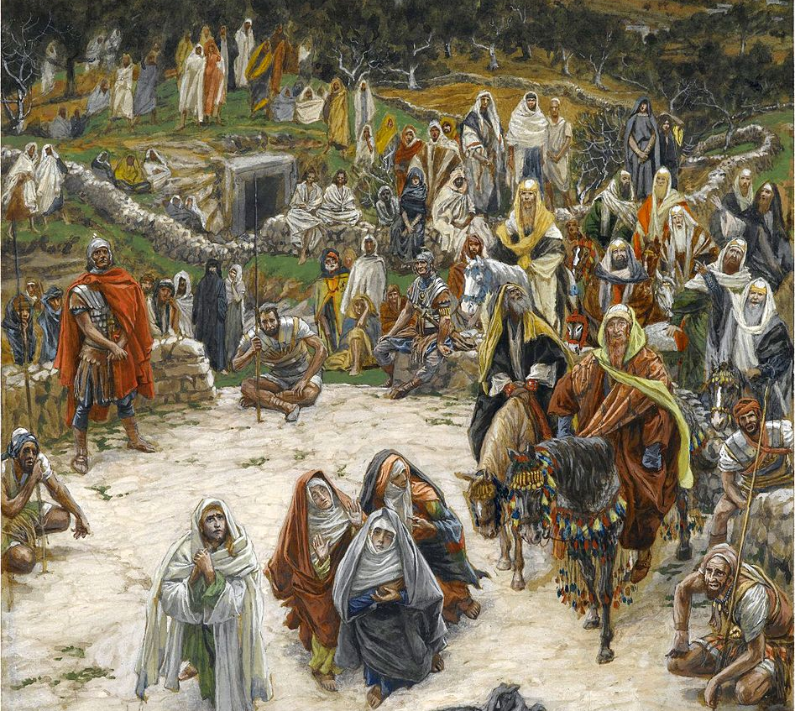
James Tissot
“What Our Lord Saw from the Cross”

Slide 7
Rev. Mark Latcovich
Pastor
St. Ladislaus Parish
Westlake, Ohio
Dean of the Suburban West Deanery

Slide 8
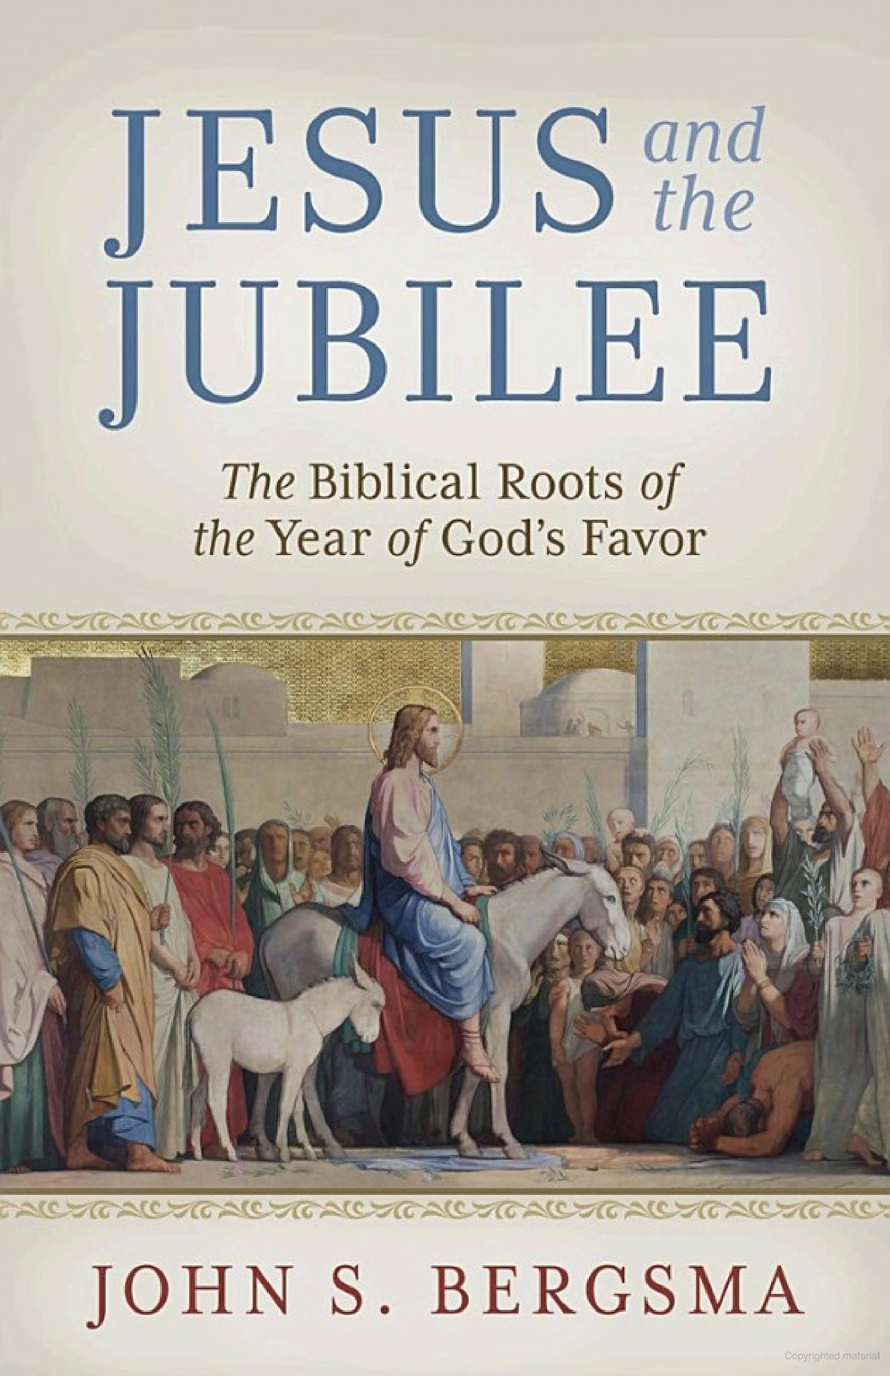

Slide 9
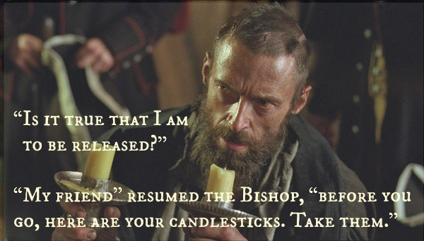

Slide 10
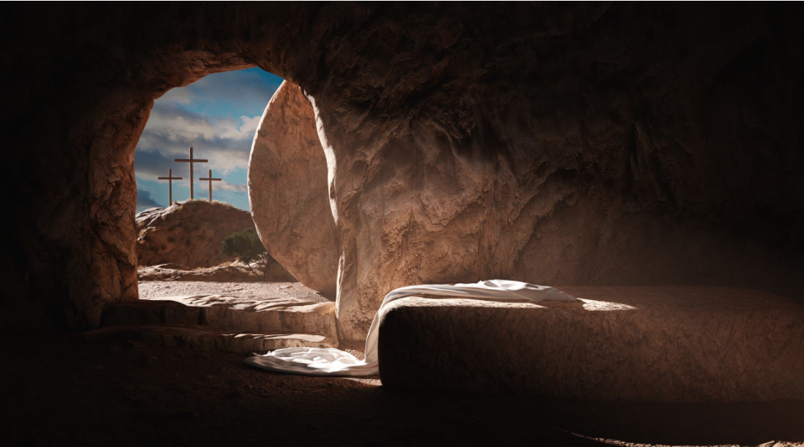

Slide 11
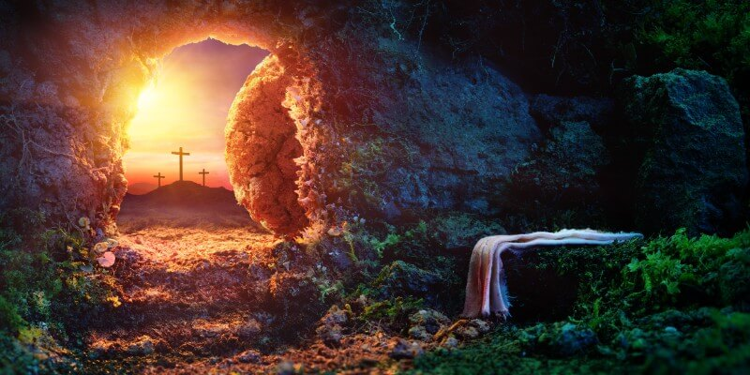

Slide 12


Slide 13
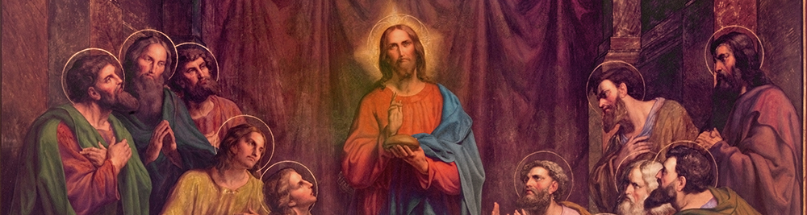

Slide 14
Rev. Stephen Moran
Pastor
St. Mary of the Immaculate Conception Parish
Wooster, Ohio
Dean of Ashland, Medina, Wayne Deanery

Slide 15
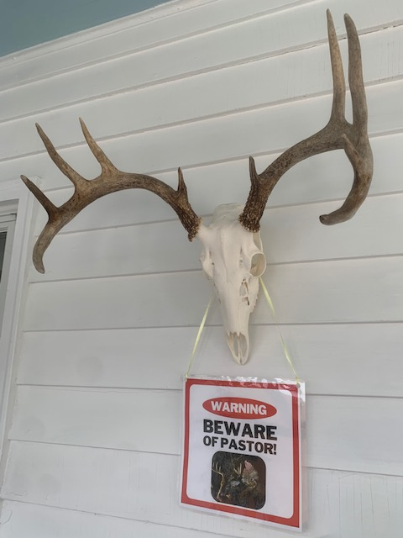

Slide 16
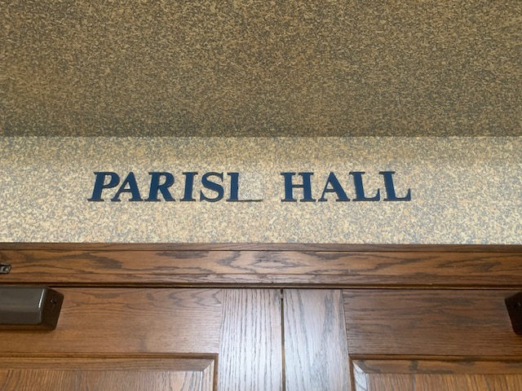

Slide 17
Rev. Joe Mamich
Secretary and Vicar for Clergy
Diocese of Cleveland

Slide 18
2018 vs. 2025
2018
2025
30 parishes out of 185 parishes (16%)
  15 Pastors
  3 Parochial Vicars
  0 Parish Life Coordinators
155 parishes with their own pastor
59 parishes out of 184 parishes (32%)
  29 Pastors
  11 Parochial Vicars
  8 Parish Life Coordinators
118 parishes with their own pastor

Slide 19
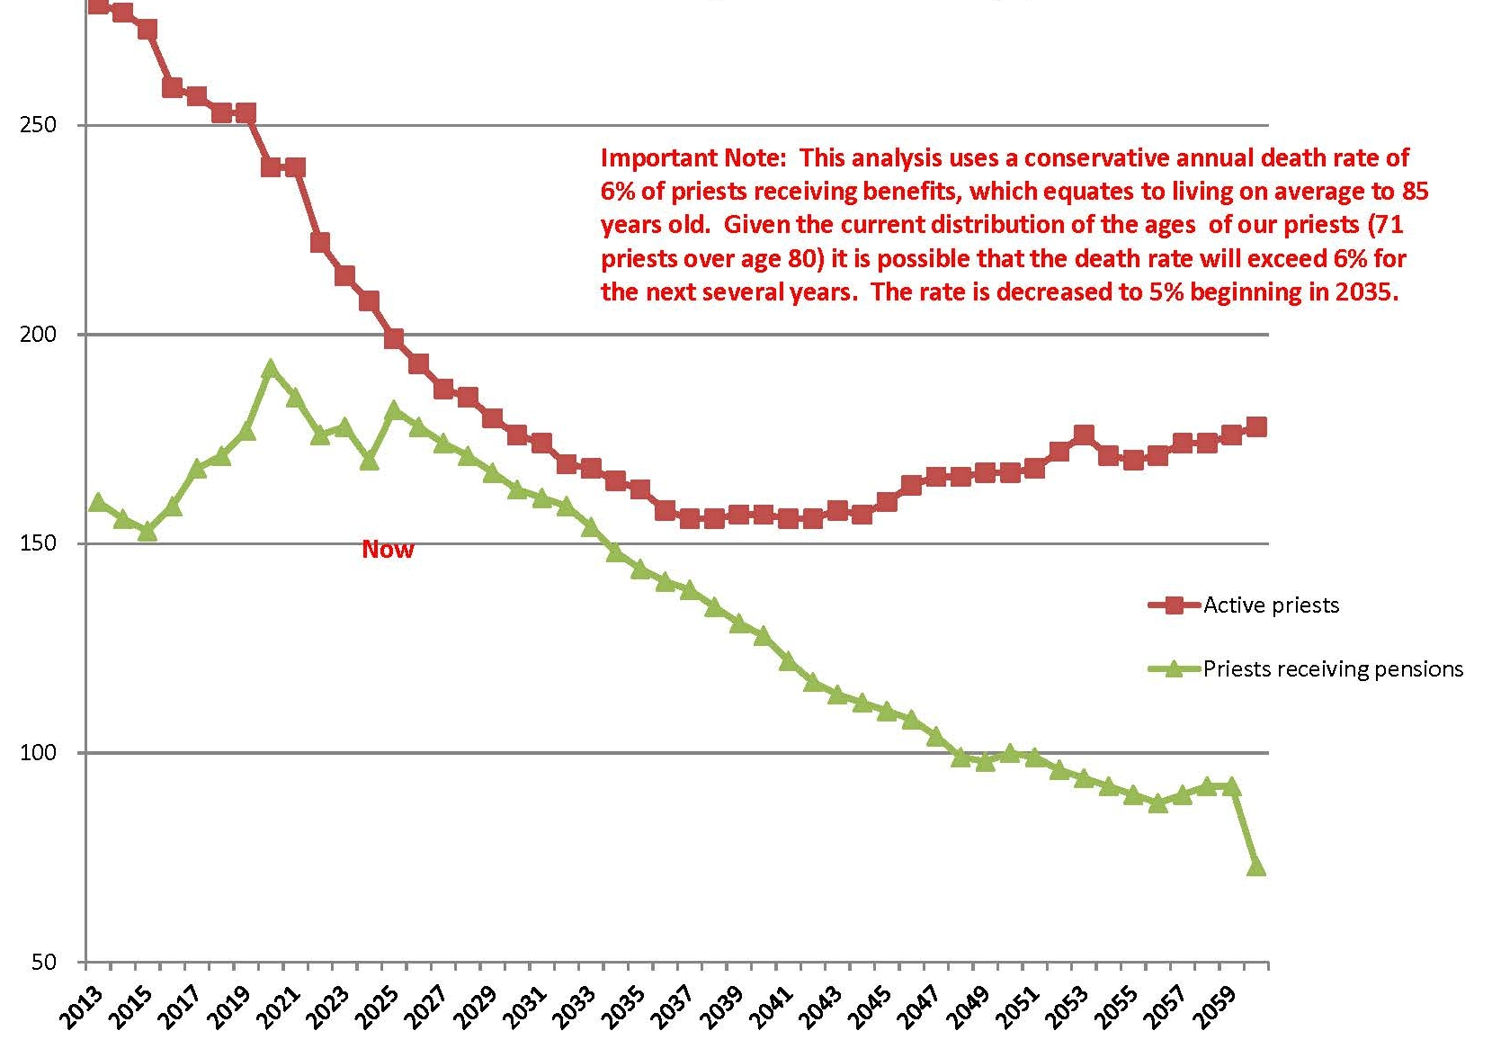
2024
Priests’ Retirement Board
Statistics

Slide 20
Fr. Patricio Aborde (Tagum, Philippines) – PV, St. Barnabas, Northfield
Fr. Joselito Clemen (Tagbilaran, Philippines) – PV, St. Christopher, Rocky River
Fr. Peter Paul Ibeagha (Mamfe, Cameroon) – Chaplain, Fairview Hospital
Fr. Lawrence Renard, OMI (Colombo, Sri Lanka) – PV, St. Rita, Solon
Fr. Felix Silagan (Tagbilaran, Philippines) – PV, Holy Family Parish, Stow
Fr. Regalado (Reg) Tiongson (Iba, Philippines) – In Residence, Cathedral of St. John the Evangelist
Fr. Arnulfo Tiplaca (Tagum, Philippines) – PV, St. Joseph, Strongsville
Fr. Paul Wirsiy (Mamfe, Cameroon) – PV, St. Brendan, North Olmsted

Slide 21
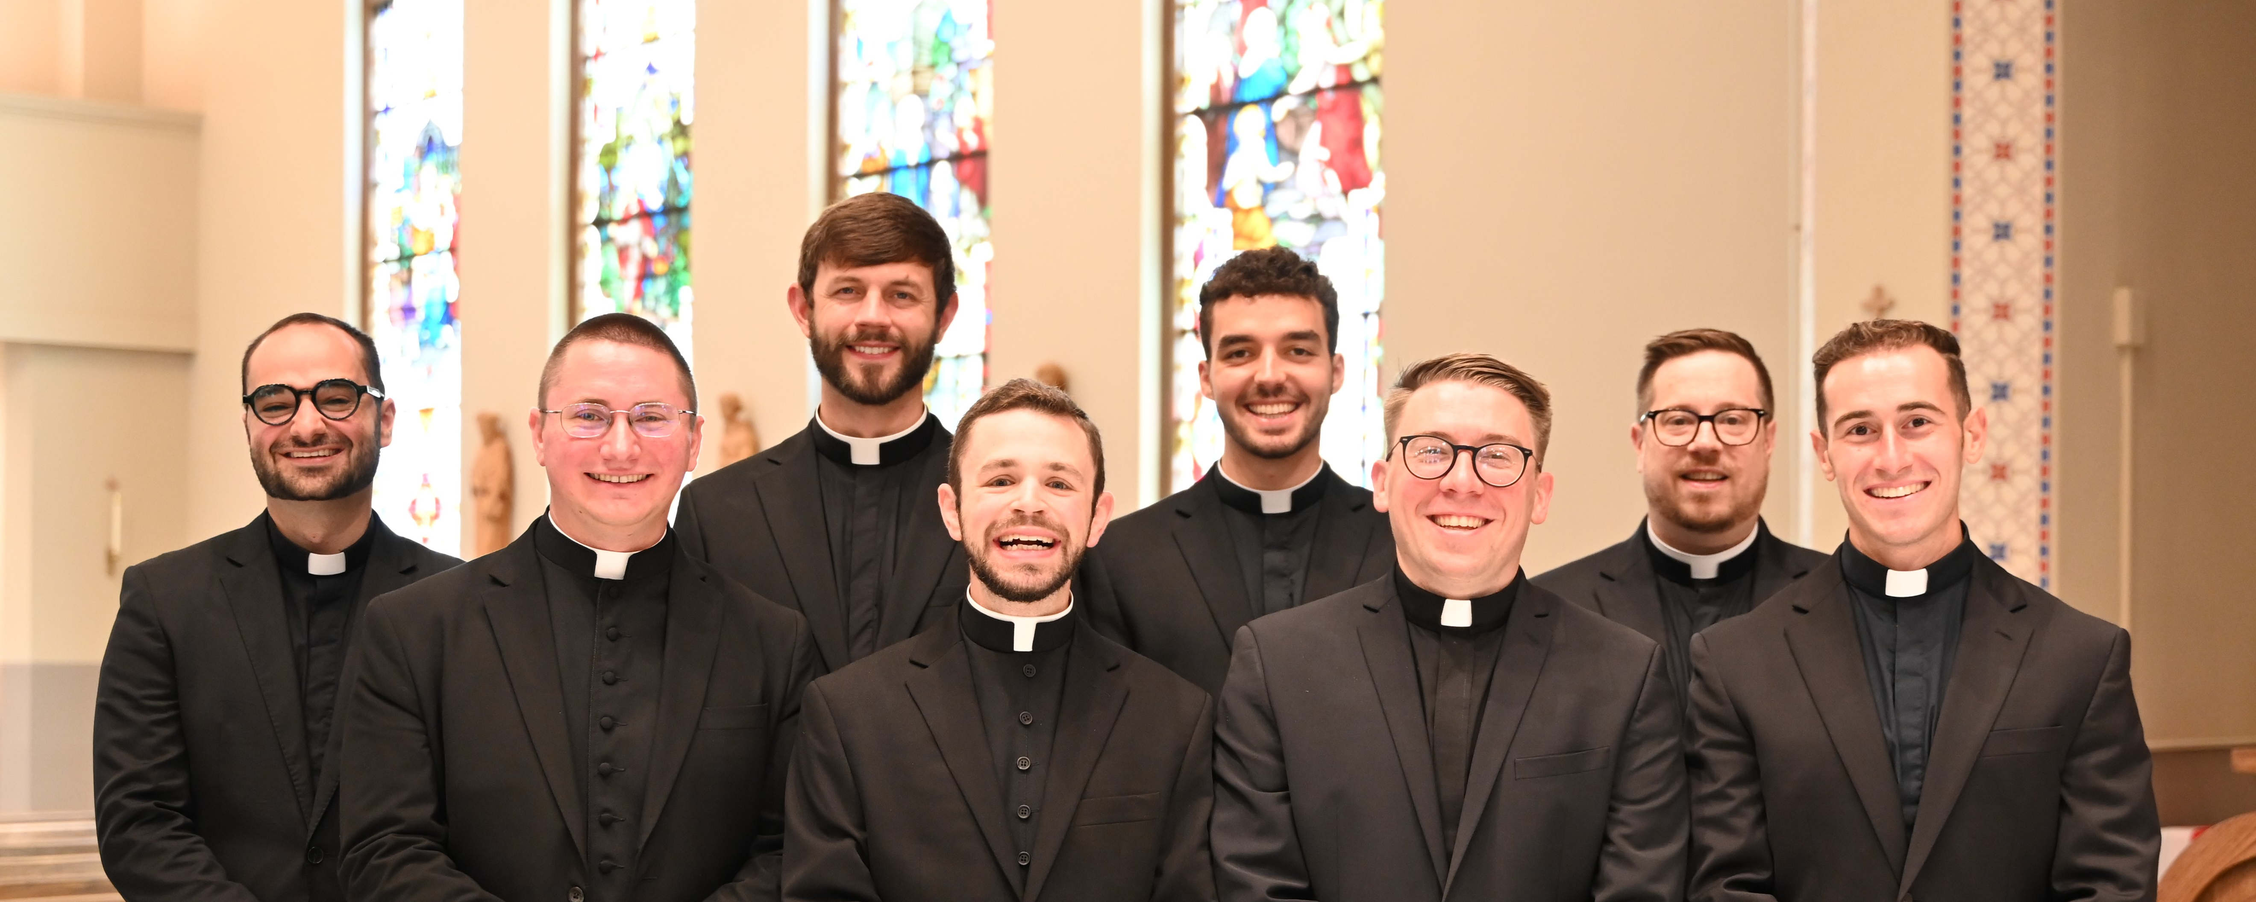
Ordination to the Priesthood is
Saturday, May 17th at 10:00am

Slide 22
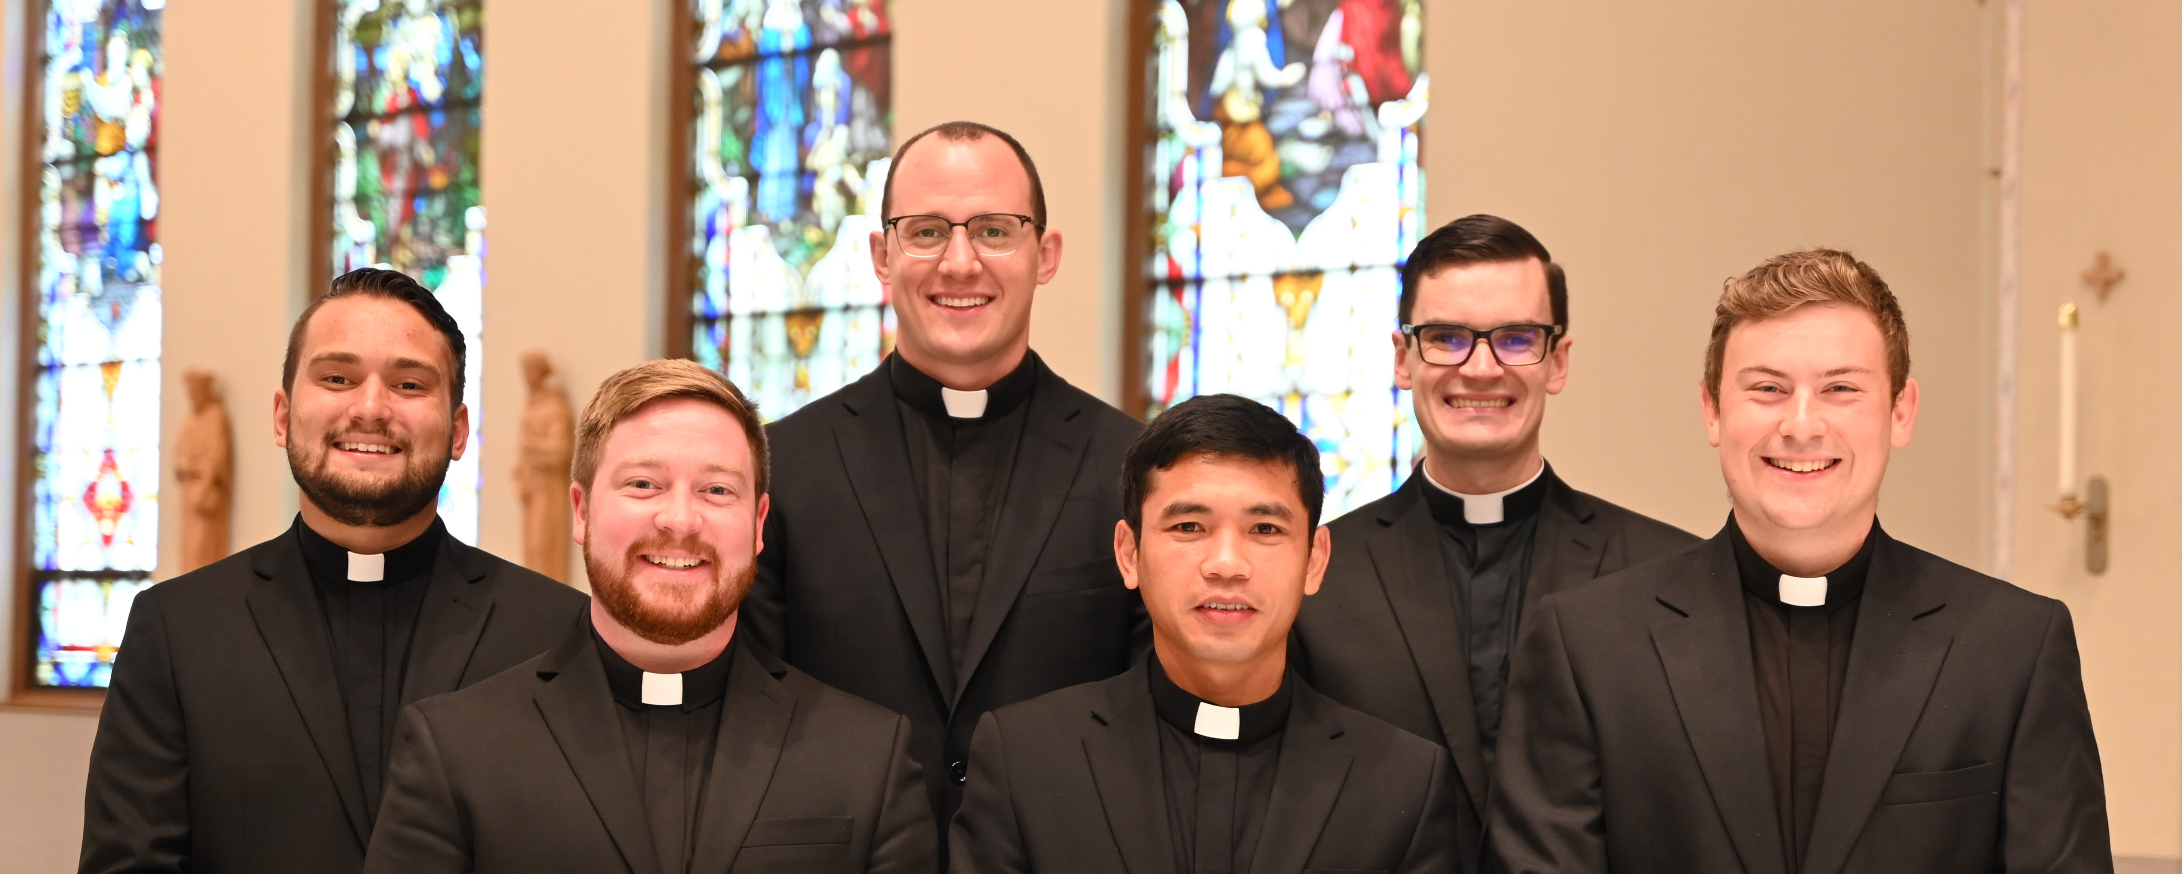
Ordination to the Diaconate was
Saturday, April 19th

Slide 23
Important Dates
Priesthood Ordination, Saturday, May 17th 10:00am
Priest Anniversary Celebration, Tuesday, May 20th
11am St. Basil the Great, Brecksville
Priest Retreat, June 9—13 at the CPL
Academy of the Good Shepherd, August 5—8 at the CPL
Clergy Cookout, Tuesday, August 12 at the CPL
Priest Retreat in Poland, Sept 29th – Oct 6th
Presbyteral Convocation is Tuesday, October 14th
10:30am -3:30pm St. Albert the Great

Slide 24
2025 Presbyteral Day of Sanctification

